Slide 1
Maize Presentation

Slide 2
overview
Introduction into previous literature
Methods of previous literature
Results of previous literature
Updated Methods
Updated Results
What's Next

Slide 3
context
Food Insecurity continues to be a serious concern for many South Africans
In 2018, 11% of individuals and 10% of households in South Africa were vulnerable to hunger
Undernourishment slightly increased from 5% to 6% from 2014 to 2017
In 2014-2015, 22% of households experienced food insecurity due to a severe drought and subsequent food price shocks
White maize serves as a staple food for the majority of the population, specifically for low-income households

Slide 4
introduction
Most research evaluating the impacts of GM crops focuses on the producer benefits of GM input traits or the influence of consumer valuation and acceptance in GM crop adoption
Specifically, the producers that have benefited the most are low income farmers in developing countries where there are fewer options for pest management and crop vulnerability tends to be higher
Other findings conclude GM input traits have second-order socioeconomic impacts such as labor-savings and environmental benefits
Many skeptics suggest that there is not clear evidence that GM maize has yield gains in South Africa that benefit producers

Slide 5
Previous methods
The data for the previous study was collected from 106 locations and 491 cultivars across 28 years and contains 58,952 observations.
Data contained both white and yellow maize, with 41% of the data being white maize
Most trials were dryland and rainfed but 17% were irrigated
While the data begins in 1980, GM cultivars do not appear until 1999

Slide 6
Data
For our current study, we took the previous data that ranged from 1980-2009 and added on data from 2010-2019.
While the methods of collection and experiments were the same, this study is being conducted in R instead of Stata
- Newer data was compiled and cleaned in the same manner as the previous data
- regressions included a linear model and a quadratic model where yield was observed based on provence, year, technology, and color.

Slide 7
Previous results
In a study done by Shew et al 2021, yield gains were found in GM maize both white and yellow.
Yield increase is estimated at .42Mt ha from genetic modification
GM maize also reduced yield risk by 8%
GM yield gains vary under different conditions including different provinces and irrigated conditions, but GM yield gains are approximately twice as large for white relative to yellow maize

Slide 8
Summary of Data

Slide 9
methods
$$yield \sim provence+factor\left(year\right)+GM+color$$
$$yield \sim provence+factor\left(year\right)+GM+year∗GM+year squared∗GM+color$$

Slide 10
Regression table Snippets

Slide 11
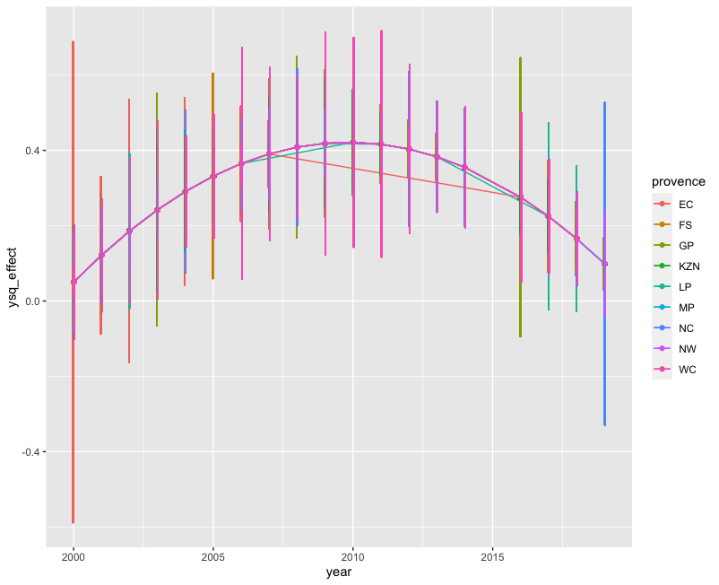

Slide 12
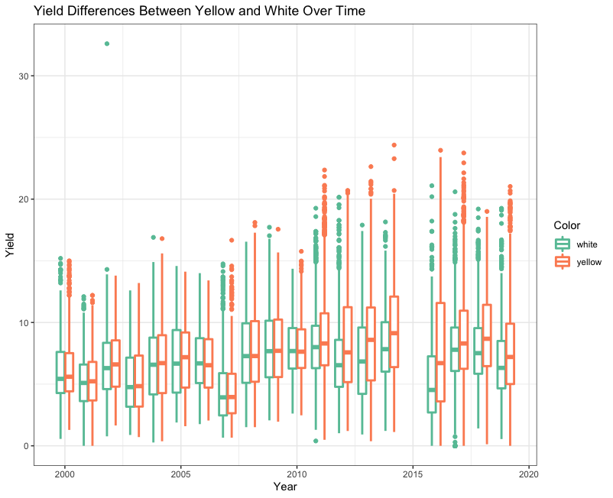

Slide 13
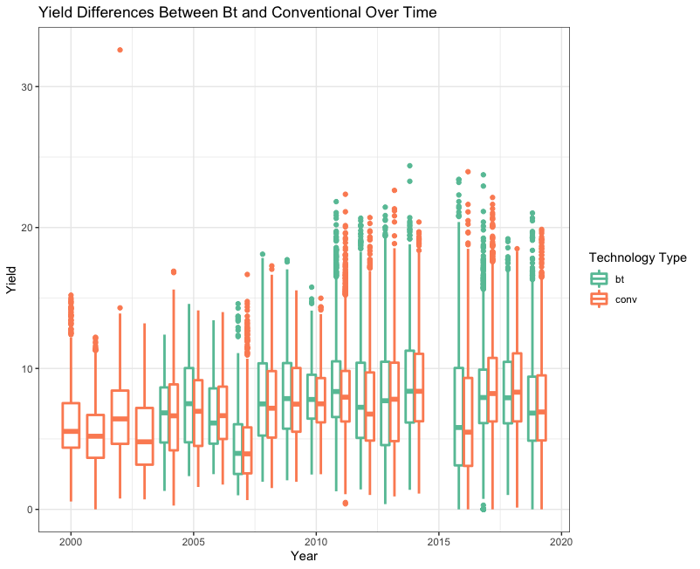

Slide 14
Next steps
Insect Resistance
Estimating the economic and production impacts of insect resistance
Breakpoint Analysis

Slide 15
Questions
Courtney Cooper- cfcooper@uark.edu
I would like to gratefully acknowledge my co-authors- Dr. Aaron Shew, Dr. Lawton Lanier Nalley, Dr. Jesse Tack, Petronella Chaminuka,
and the South African ARC

